Slide 1

Smart Exhibition with Supercollider
2013040009 유명성
2013039033 이천솔
2014040045 서상원

Slide 2
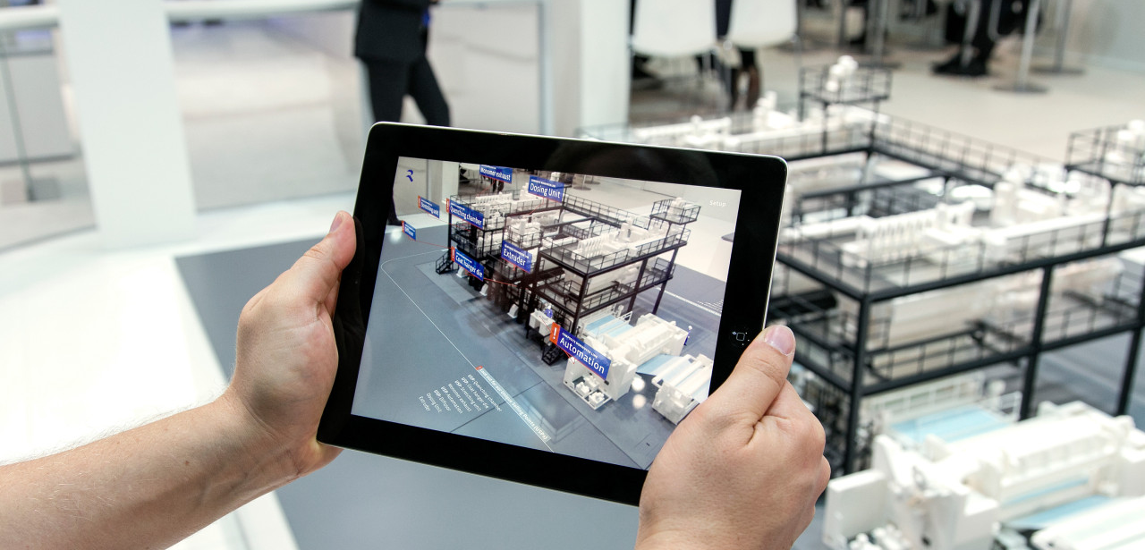


Smart Exhibition with AR and Radio Music

Slide 3


1. Overview
1.1 System Architecture
RF Music
Cloud Server
AP2
RF to SC Script Middleware
2
Collect RF signals through module
Send signals into Cloud
Convert RF signals into SC values
Interpret SC values
Play RF music
Eth
Radio Collection Module
3
Super Collider
Interpreter/Server
1
BLE
Mon
AP1
4
1
Video
Audio
Picture 1
Picture 2
Content Server
AR exhibit
1
1
Collect BLE signal through phone
Show AR exhibit
5
Display AR Contents of Picture 1
Send/Recv
Play RF Music of Picture 1
Sniffing
< Smart Exhibition >

Slide 4
Q & A

